Slide 1

Research Proposal
Human-AI Collaboration based on Explainable NLP in Medical Domain
Developing a new computer-aided Clinical Decision Support System
HADI MOHAMMADI
October, 2022

Slide 2






Introduce
About Proposal
CONTENTS
Advantages
Trend Analysis
Similar Application
Scheduling

Slide 3
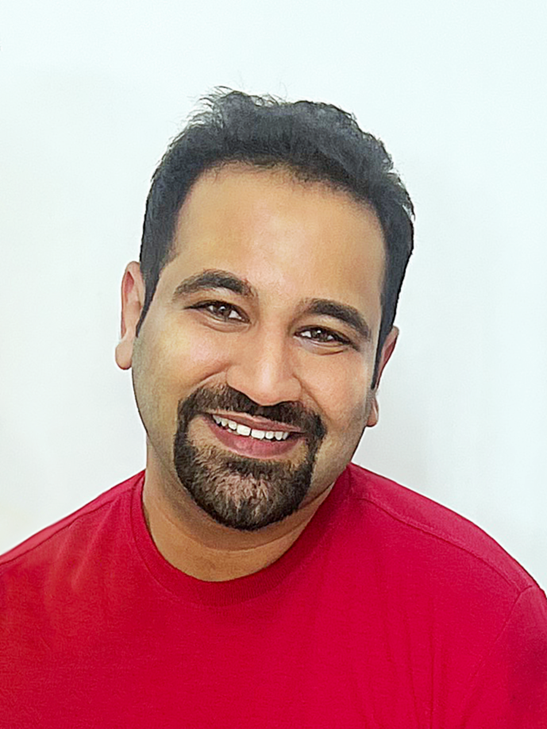







Introduce
HADI MOHAMMADI
Academic Experience:
MSc in Industrial Engineering at University of Tehran (GPA:18.96/20)
Thesis: Dynamic pricing with demand learning using reinforcement learning in the non-stationary environment by considering customer behavior (A Data-driven Approach) (Grade: Excellent)
TA: Econometrics (OLS with SPSS and Python), Data Mining (hands on Python), Advanced Simulation (Agent based Simulation in Python), Dynamic Programming (hands on in Python)
Work Experience:
Back to Agenda Page
https://hadimohammadi.info/
Data Scientist in Customer Behavior (CRM department of The largest manufacturer of household appliances in Iran)
Data Scientist in Bdood Bikes (Forth generation of Sharing bicycle system company in Iran)
Hadi.mohammadi@outlook.com
Mohammadi-hadi
International Experience:
Tehran, Iran
TU Delft Summer School (Student in Explainable AI), Neuromatch Academy (lead teaching assistant in Deep learning Summer School), Upwork (doing International Project).

Slide 4
Introduce
HADI MOHAMMADI
Hard Skills:
Soft Skills:
Programming Languages
R programming
Python
SQL
Software Skills
SPSS
Gams
Vensim
Arena Simulator
LaTex
Other
Data analysis
Statistical Modeling
Deep Learning
Reinforcement Learning
Mathematical Modeling
Dynamic programming
Experience as graduate
Teaching Assistant
Research Assistant
Working as a team
Academia
Industry
Collaborating with students from other country
Neuromatch Academy
Delft University of technology
Other
Presenting Skills
Enthusiastic about learning new things
https://hadimohammadi.info/
Back to Agenda Page
Hadi.mohammadi@outlook.com
Mohammadi-hadi
Tehran, Iran

Slide 5

HADI MOHAMMADI
Introduce
Experience in HealthCare and Social Science
# | Publication
1 | Home Health Care Problem with Synchronization Visits and Considering Samples Transferring Time: A Case Study in Tehran
2 | Discrete Simulation of Hospital Patient Service System
3 | A dynamic model for investigating the role of smoking on the incidence of lung cancer with a social policy approach
4 | Investigation of Economic and Social Factors Affecting Population Growth in Iran: An Econometric Approach

Slide 6


About Proposal
Back to Agenda Page

Slide 7

About Proposal
Developing a new computer-aided Clinical Decision Support System
# | Topics | Aim
1 | Explainable NLP (EXNLP) for IR from EHRs | To enhance IR from e-health systems
2 | Explainable NLP for CDSS (EXNLP-CDSS) | To design an effective and accurate explanation for predicting possible diseases
3 | Human-AI Collaboration: Evaluation of EXNLP-CDSS | To describe an evaluation of EXNLP-CDSS by collaboration between humans and AI
4 | Agent-based EXNLP-CDSS | To present autonomous agents

Slide 8
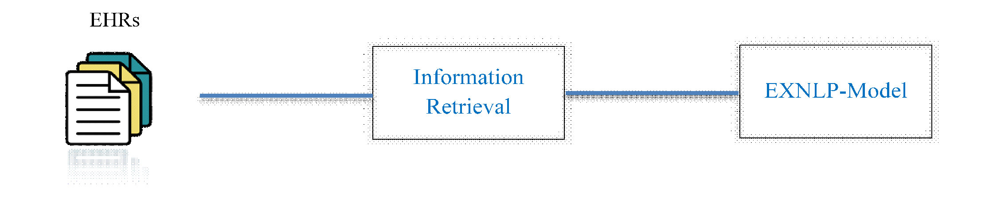
About Proposal
Topic 1
The procedure of the 1st topic
disease-specific
historical medical data
extraction information
extract meaningful information by NLP techniques
Prepare explanation

Slide 9
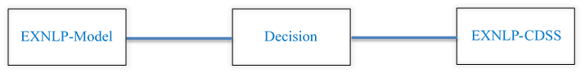
About Proposal
Topic 2
The procedure of the 2nd topic
Transparently explanation
Ethical and equitable decision-making

Slide 10
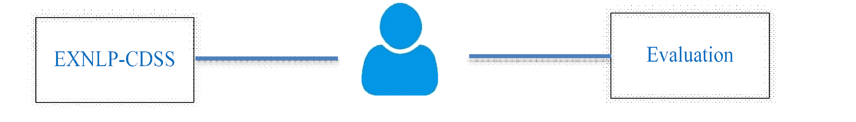
About Proposal
Topic 3
The procedure of the 3rd topic
physicians
Evaluation EXNLP-CDSS performance as follow:
Support the diagnoses process.
Prevent diagnostic errors.

Slide 11
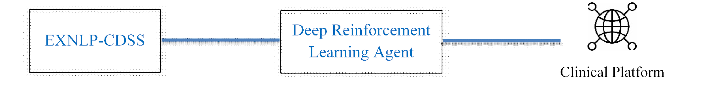
About Proposal
Topic 4
The procedure of the 4th topic
Difficult to manage
Simplify the process
Autonomous explainable agents

Slide 12

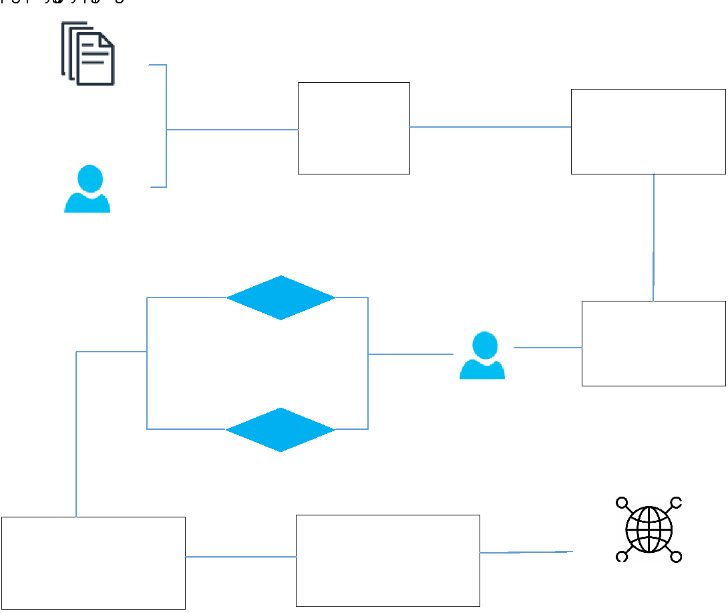
About Proposal
High-level overviews
INPUT TEXT
Patient historical medical data
Patient Symptom
EXNLP
A reliable explanation of
the Possibilities diagnosis
CDSS
Prioritizing patients
(emergency and non-emergency)
Setting up doctor's appointment
Suggesting medical procedures

Slide 13
Advantages
Medical Service Availability
Back to Agenda Page
Patients
Cost-effectiveness
(EXNLP-CDSS)
health care system
Prioritizing patients
Preventing diagnostic errors
Physicians
Effective time distribution
Increase efficiency
Having an accurate explanation
Supporting differential diagnoses

Slide 14

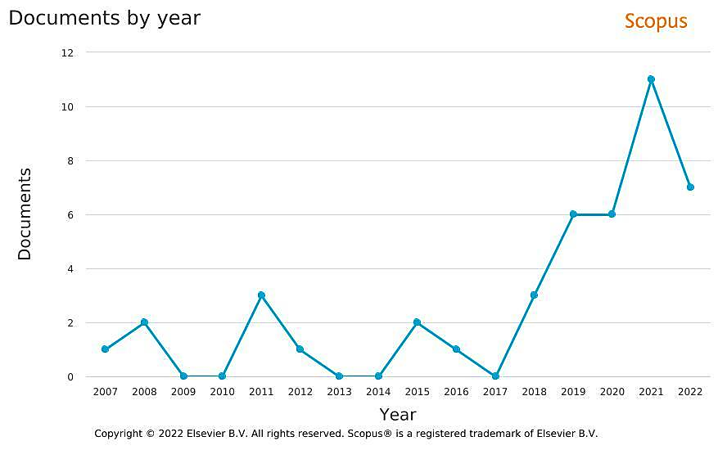
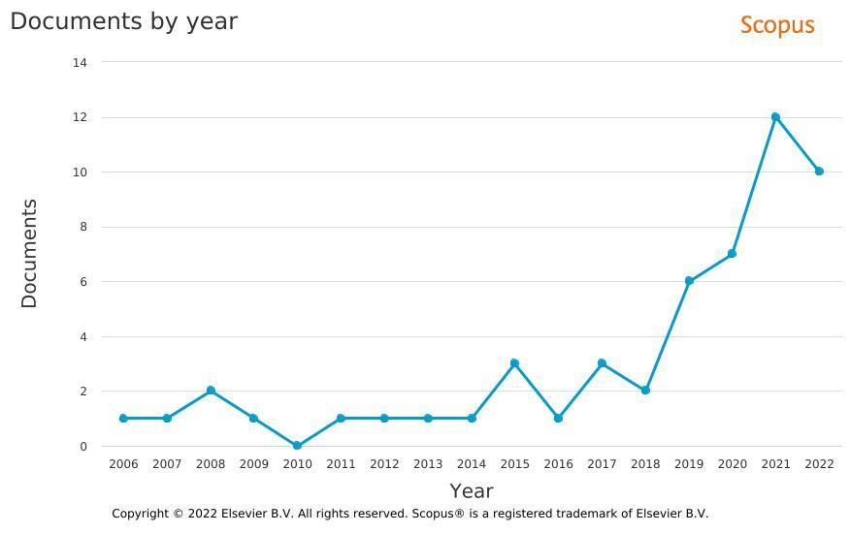

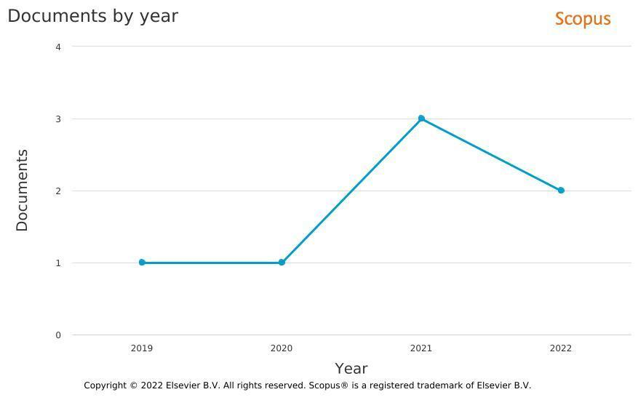
Trend
Trend Analysis
1
2
3
4

Slide 15
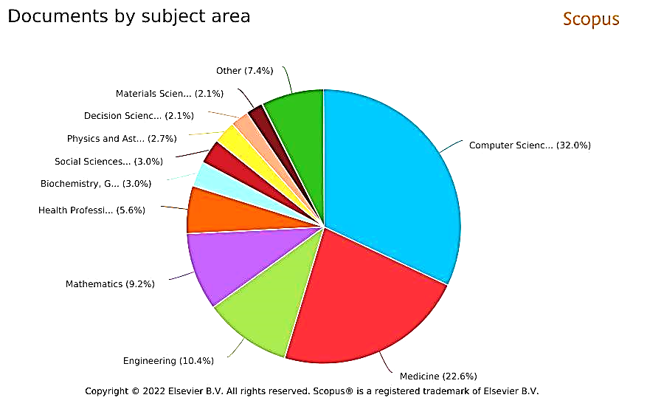
Trend
Trend Analysis
32%
Computer Science
22.6%
Medicine
10.4%
Engineering
9.2%
Mathematics
The most subject areas in this field

Slide 16




Similar Application
EBMEDS is a service for clinical decision support. It combines patient specific data (drugs, diagnosis, laboratory investigations, risk factors, previous procedures) with current and curated medical knowledge.
The EBMEDS takes structured patient data from EHRs and sends back reminders, medical solutions and diagnosis-specific links to guidelines.

Slide 17

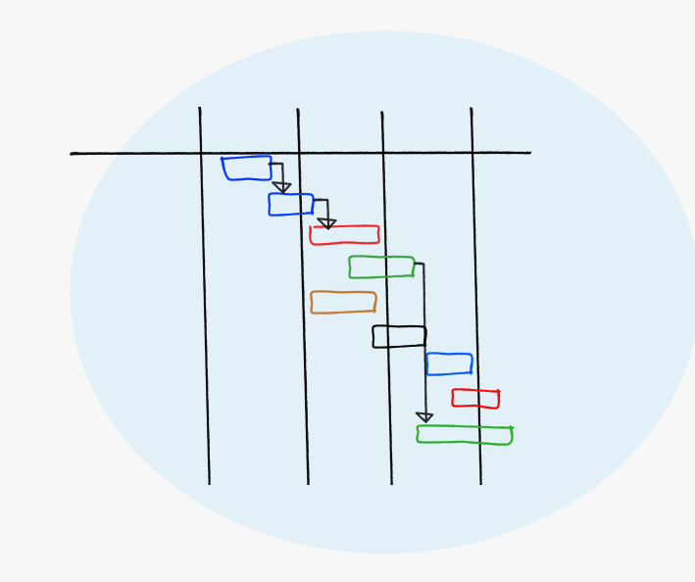
Scheduling
Time Line
Q1
Q3
Q5
Q7
1st milestone
Q2
Q4
5th milestone
Q6
7th milestone
3rd milestone
2nd milestone
4th milestone
6th milestone
Link to Gantt Chart

Slide 18

Scheduling
PHD position
Passion to work on the edge of knowledge
Focus and statistical vision in machine learning problems
Why?
Utrecht University
Well Known University and friendly atmosphere
Interested in working in the interaction of data science and social (Human) sciences
Question
Answer
Netherland
Favorable weather, peace, beauty, economic justice, good education and transportation system, etc.
Experience three weeks living in the Netherlands

Slide 19
Scheduling
What Should I be Doing in this regard?
Learning more about Explainable AI (TU Delft Summer School, LinkedIn and Udemy Courses)
Improve my NLP knowledge (Coursera / Udacity Course)
Increase language knowledge (English/ Dutch) for a more in-depth review of medical documentation
Increasing teaching and research ability

Slide 20
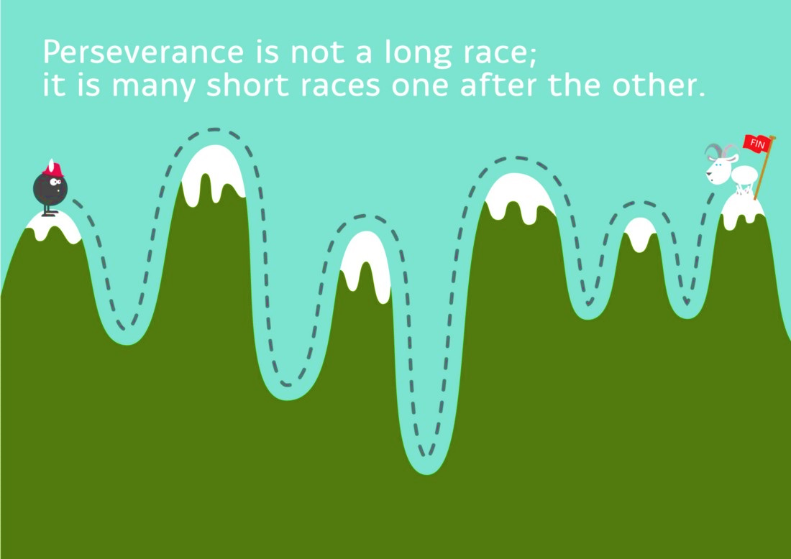
Scheduling

Slide 21
Thank You
Back to Agenda Page

